Slide 1

IE 260 – ENGINEERING ECONOMY Chapter 9 Replacement Analysis
U. MAHİR YILDIRIM

Slide 2

Chapter 9
The objective of Chapter 9 is to address the question of whether a currently owned asset should be kept in service or immediately replaced.

Slide 3
Introduction
A decision situation often encountered in business firms and government organizations, as well as by individuals, is whether an existing asset should be retired from use, continued in service, or replaced with a new asset.
Engineering economy studies of replacement situations are performed using the same basic methods as other economic studies involving two or more alternatives.

Slide 4

Defender vs Challenger
Often the decision is whether to replace an existing (old) asset, descriptively called the defender, with a new asset.
The single or more alternative replacement (new) assets are then called challengers.

Slide 5

Reasons for Replacement

Slide 6



Reasons for Replacement Analysis Physical Impairment (Deterioration)
These are changes that occur in the physical condition of an asset
routine maintenance and breakdown repair costs increase,
energy use may increase ,
more operator time may be required.
Also some unexpected incident such as an accident may occur that affects the physical condition
In short, wear that is overly expensive to repair

Slide 7

Reasons for Replacement Analysis Altered Requirements
Capital assets are used to produce goods and services that satisfy human needs/wants.
When the demand for a good or service either increases or decreases or the design of a good or service changes, the related asset(s) may have the economics of its use affected.

Slide 8
Reasons for Replacement Analysis Altered Requirements (cont'd)
World wide trade visualization
https://resourcetrade.earth/data

Slide 9
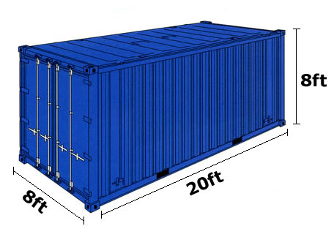
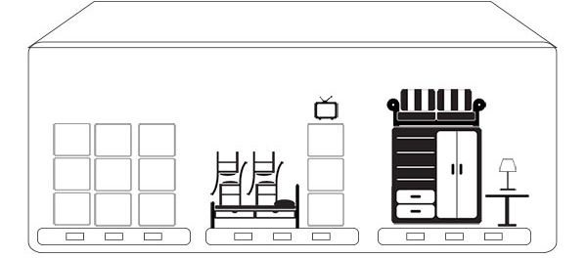
TEU
What fits in a 20 foot container?
Twenty-foot equivalent unit
Household goods from a 110 m² apartment

Slide 10
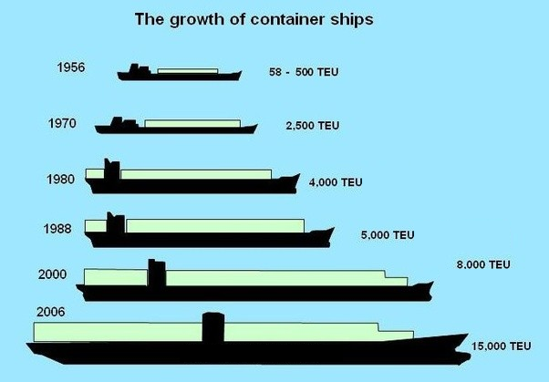
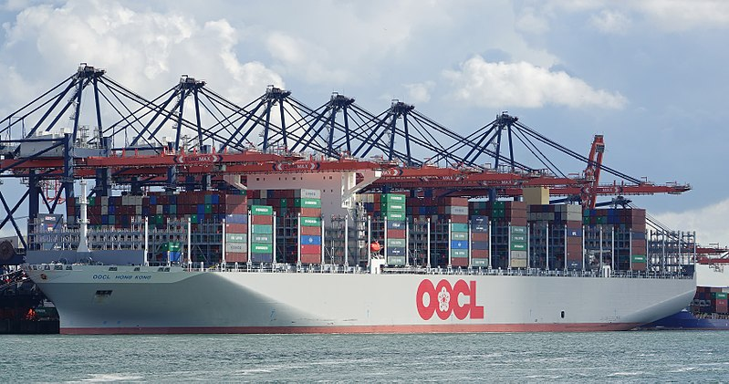
Reasons for Replacement Analysis Altered Requirements (cont'd)
Container ship capacity ?
As of 2017
Overall length: 400.0 m
Maximum TEU: 21,413

Slide 11
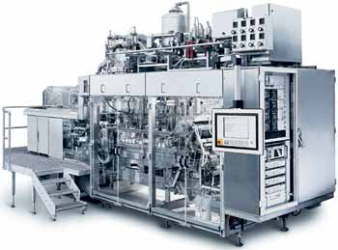

Reasons for Replacement Analysis Technology
The costs per unit of production, as well as quality and other factors, are favorably impacted by changes in technology, which result in more frequent replacement of existing assets with new and better challengers.
"... A filling machine for aseptic carton packaging with an output of 10,000 per hour was introduced to market in 1997. With the introduction of servo motors, the output of the filling machines has increased by 20 percent up to 12,000 packages per hour on the filling machines for the popular family sized packages. ..."

Slide 12
Reasons for Replacement Analysis
Reason 2 (altered requirements) and Reason 3 (technology) are sometimes referred to as different categories of obsolescence.
Obsolescence is the state of being which occurs when an object, service, or practice is no longer wanted even though it may still be in good working order.
In any replacement problem, factors from more than one of these three major areas may be involved. Regardless of the specific considerations, the replacement of assets often represents an economic opportunity for the firm.

Slide 13
Various types of lives for typical assets
Economic life is the period of time (years) that results in the minimum equivalent uniform annual cost (EUAC) of owning and operating an asset.
Ownership life is the period between the date of acquisition and the date of disposal by a specific owner. A given asset may have different categories of use by the owner during this period.
Physical life is the period between original acquisition and final disposal of an asset over its succession of owners. For example, the car just described may have several owners over its existence.
Useful life is the time period (years) that an asset is kept in productive service (either primary or backup). It is an estimate of how long an asset is expected to be used in a trade or business to produce income.
Economic life is the period of time (years) that results in the minimum equivalent uniform annual cost (EUAC) of owning and operating an asset.
Ownership life is the period between the date of acquisition and the date of disposal by a specific owner. A given asset may have different categories of use by the owner during this period.
Physical life is the period between original acquisition and final disposal of an asset over its succession of owners. For example, a car may have several owners over its existence.
Useful life is the time period (years) that an asset is kept in productive service (either primary or backup). It is an estimate of how long an asset is expected to be used in a trade or business to produce income.

Slide 14
Book Value & Market Value
Book value (BV) of an asset is the value at which the asset is carried on a balance sheet and calculated by taking the cost of an asset minus the accumulated depreciation.
Depreciation is the decrease in value of physical properties with the passage of time and use. More specifically, depreciation is an accounting concept that establishes an annual deduction against before-tax income such that the effect of time and use on an asset’s value can be reflected in a firm’s financial statements
Depreciation calculator - http://www.calculator.net/depreciation-calculator.html
Market value (MV) is the amount that will be paid by a willing buyer to a willing seller for a property.

Slide 15
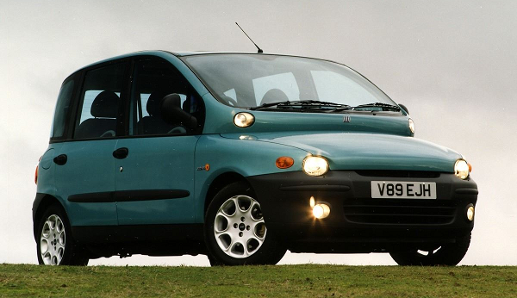

Book Value & Market Value
Which one is larger ?

Slide 16
Sunk Cost
We define a sunk cost to be the difference between an asset’s book value (BV) and its market value (MV) at a particular point in time.
Sunk costs have no relevance to the replacement decisions that must be made.

Slide 17

Outsider Viewpoint
We will use the so-called outsider viewpoint for approximating the investment worth of an existing asset (defender).
In particular, the outsider viewpoint is the perspective that would be taken by an impartial third party to establish the fair MV of a used (secondhand) asset.

Slide 18
Existing Asset's Value/Price ?
The present realizable MV is the correct capital investment amount to be assigned to an existing asset in replacement studies. How ?
If it is decided to keep the existing asset, we are giving up the opportunity to obtain its net realizable MV at that time. Therefore, this situation represents the opportunity cost of keeping the defender.
What if any new investment expenditure (such as for overhaul) is needed to upgrade the existing asset so that it will be competitive in level of service with the challenger?
the extra amount should be added to the present realizable MV to determine the total investment in the existing asset for replacement study purposes

Slide 19
Existing Assets Value (cont’d)
When using the outsider viewpoint,
The opportunity cost of not selling the existing asset for its current MV
The cost of upgrading it to be competitive with the best available challenger
The total investment in the defender
=
+
All feasible challengers are to be considered

Slide 20
Example Investment Cost of the Defender (Existing Asset)
The purchase price of a certain new automobile (challenger) being considered for use in your business is $21,000. Your firm’s present automobile (defender) can be sold on the open market for $10,000. The defender was purchased with cash three years ago, and its current BV is $12,000. To make the defender comparable in continued service to the challenger, your firm would need to make some repairs at an estimated cost of $1,500.
What is the total capital investment in the defender, using the outsider viewpoint?
What is the unamortized value of the defender?

Slide 21
Solution (a) Investment Cost of the Defender (Existing Asset)
The total capital investment in the defender (if kept) is its current MV (an opportunity cost) plus the cost of upgrading the car to make it comparable in service to the challenger.
Hence, the total capital investment in the defender is
$10,000 + $1,500 = $11,500 (from an outsider’s viewpoint).
This represents a good starting point for estimating the cost of keeping the defender.

Slide 22
Solution (b) Investment Cost of the Defender (Existing Asset)
The unamortized value of the defender is the book loss (if any) associated with disposing of it.
Given that the defender is sold for $10,000, the unamortized value (loss) is
$12,000-$10,000 = $2,000.
This is the difference between the current MV and the current BV of the defender.

Slide 23
Typical Replacement Problems
The following typical replacement situations are used to illustrate several of the factors that must be considered in replacement studies.
These analyses use the outsider viewpoint to determine the investment in the defenders.

Slide 24
Example Replacement Analysis Using Present Worth (Before Taxes)
A firm owns a pressure vessel that it is considering replacing. The old pressure vessel has annual operating and maintenance expenses of $60,000 per year and it can be kept for five more years, at which time it will have zero MV. It is believed that $30,000 could be obtained for the old pressure vessel if it were sold now.
A new pressure vessel can be purchased for $120,000. The new pressure vessel will have a MV of $50,000 in five years and will have annual operating and maintenance expenses of $30,000 per year. Using a before-tax MARR of 20% per year, determine whether or not the old pressure vessel should be replaced. A study period of five years is appropriate.

Slide 25
Solution Replacement Analysis Using Present Worth (Before Taxes)
The first step in the analysis is to determine the investment value of the defender (old pressure vessel). Using the outsider viewpoint, the investment value of the defender is ?
We can now compute the PW (or FW or AW) of each alternative and decide whether the old pressure vessel should be kept in service or replaced immediately.
Defender: PW(20%) = -$30,000 - $60,000(P/A, 20%, 5) = -$209,436
Challenger: PW(20%) = -$120,000 - $30,000(P/A, 20%, 5) + $50,000(P/F, 20%, 5) = -$189,623
The PW of the challenger is greater (less negative) than the PW of the defender. Thus, the old pressure vessel should be replaced immediately. (The equivalent uniform annual cost (EUAC) of the defender is $70,035 and that of the challenger is $63,410.)
$30,000, its present MV.

Slide 26
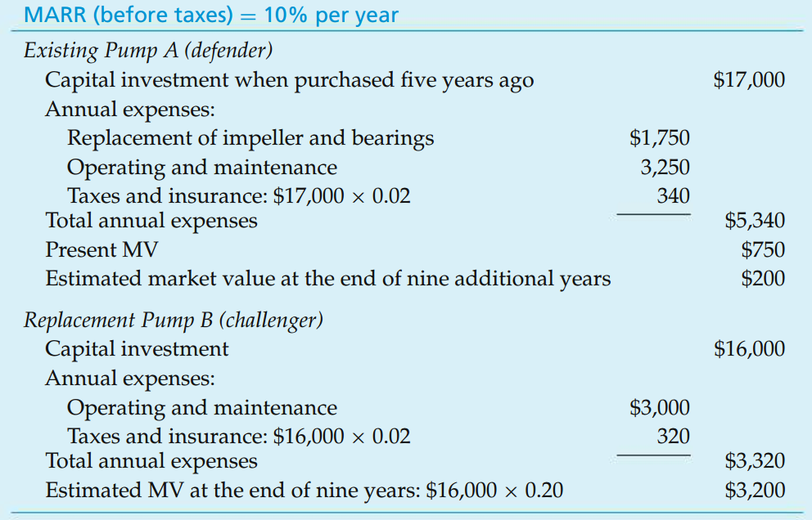
In-class Exercise Before-Tax Replacement Analysis Using EUAC

Slide 27
In-class Exercise Solution Before-Tax Replacement Analysis Using EUAC
In an analysis of the defender and challenger, care must be taken to correctly identify the investment amount in the existing pump.
Based on the outsider viewpoint, this would be the current MV of $750; that is, the opportunity cost of keeping the defender. Note that the investment amount of Pump A ignores the original purchase price of $17,000. Using the principles discussed thus far, a before-tax analysis of EUAC of Pump A and Pump B can now be made.

Slide 28
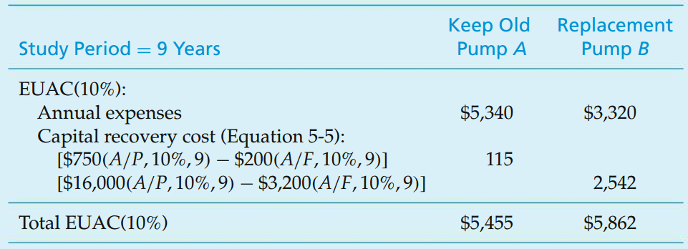
In-class Exercise Solution (cont’d) Before-Tax Replacement Analysis Using EUAC
Because Pump A has the smaller EUAC ($5,455 < $5,862), the replacement pump is apparently not justified and the defender should be kept at least one more year. We could also make the analysis using other methods (e.g., PW), and the indicated choice would be the same.

Slide 29
Determining the Economic Lives
The economic life of an asset
the time that results in the minimum EUAC of owning and operating the asset.
sometimes referred to as minimum-cost life or
optimum replacement interval.
Sometimes in practice the useful lives of the defender and the challenger(s) are not known and cannot be reasonably estimated.
The time an asset is kept in productive service might be extended indefinitely with adequate maintenance and other actions, or it might be suddenly jeopardized by an external factor such as technological change.

Slide 30

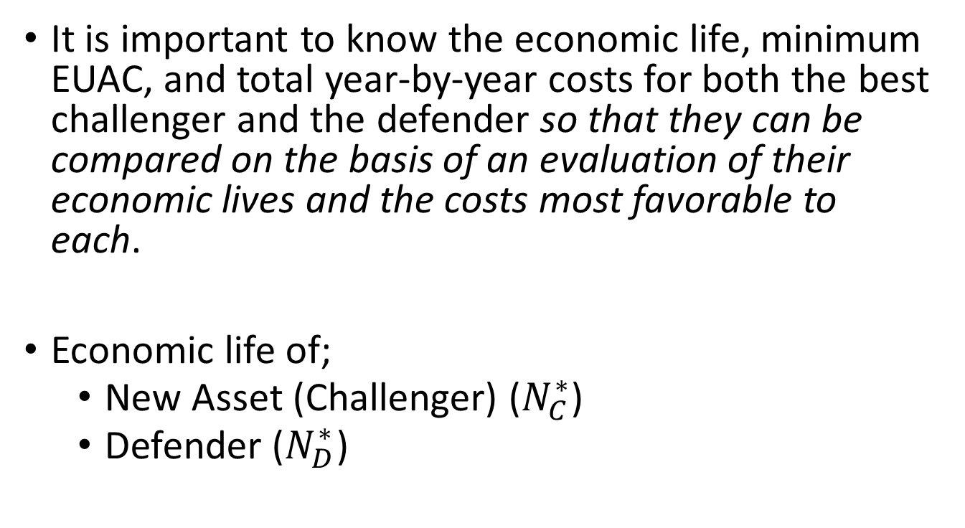
Determining the Economic Lives (cont’d)
It is important to know the economic life, minimum EUAC, and total year-by-year costs for both the best challenger and the defender so that they can be compared on the basis of an evaluation of their economic lives and the costs most favorable to each.
Economic life of;
New Asset (Challenger) ($N_{C}^{∗}$)
Defender ($N_{D}^{∗}$)

Slide 31

Determining the Economic Life New Asset (Challenger)
For a new asset, its EUAC can be computed if the capital investment, annual expenses, and year-by-year MVs are known or can be estimated.
The estimated initial capital investment, as well as the annual expense and MV estimates, may be used to determine the PW through year k of total costs, PW_{k}.
That is, on a before-tax basis,
PW of the MV at the end of year k
initial capital investment
PW of annual expenses (E_{j}) through year k

Slide 32
Determining the Economic Life New Asset (Challenger) (cont’d)
The total marginal cost for each year k, TC_{k}, is calculated using PW_{k}(i%) equation by finding the increase in the PW of total cost from year k-1 to year k and then determining the equivalent worth of this increase at the end of year k. That is;
The algebraic simplification of this relationship results in the formula
the annual expenses incurred in year k
sum of the loss in MV during the year of service
the opportunity cost of capital invested in the asset at the beginning of year k

Slide 33

Example EUAC & Economic Life of a Challenger (New Asset) given TC_{k}
EUAC through year 1 = TC₁
Note that because of the rounding, this value is found to be 5000.2 using tables.
EUAC through year 2 = TC₂
[5000*0.8696+4000*0.7561] * 0.6151
[ 7372.4 ] * 0.6151 = 4534.763
EUAC through year 3 = TC₃
[5000*0.8696+4000*0.7561+ 6000*0.6575] * 0.4380
[ 11317.4 ] * 0.4380 = 4957.021
End of Year | Total Marginal Cost for Year (TC_{k}) | EUAC through year k
0
1 | 5000 | 5000.000
2 | 4000 | 4534.763
3 | 6000 | 4957.021
End of Year | Total Marginal Cost for Year (TC_{k}) | EUAC through year k
0
1 | 5000 | 5000.000
2 | 4000 | 4534.763
3 | 6000 | 4957.021
If the before-tax MARR is 15% per year, how long should the asset be retained in service?

Slide 34
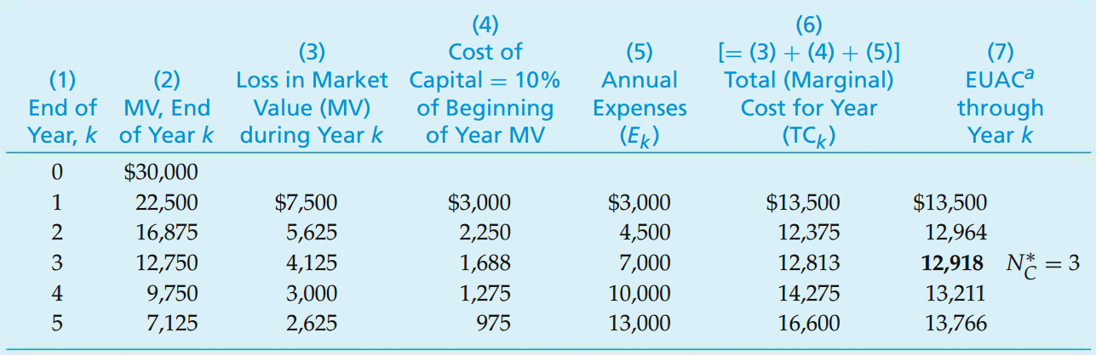
Example Economic Life of a Challenger (New Asset)
A new forklift truck will require an investment of $30,000 and is expected to have year-end MVs and annual expenses as shown on the right. If the before-tax MARR is 10% per year, how long should the asset be retained in service?

Slide 35
Solution Economic Life of a Challenger (New Asset)

Slide 36
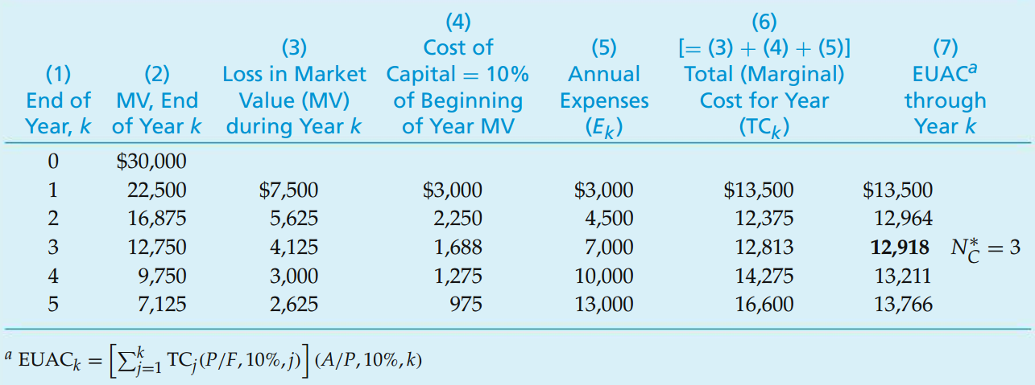
Solution Economic Life of a Challenger (New Asset)

Slide 37
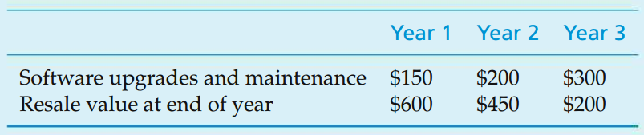
Example Economic Life of a Laptop Computer
Determine the economic life of an $800 laptop computer. Your personal interest rate is 10% per year. Annual expenses and year-end resale values are expected to be the following:
You should obtain the marginal costs (TC_{k}) first.

Slide 38
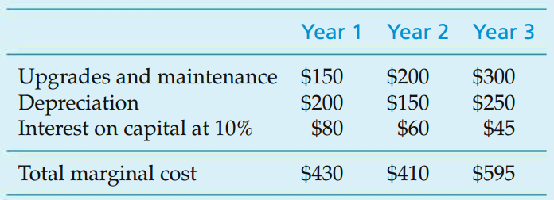
Solution Economic Life of a Laptop Computer
The marginal cost of keeping the computer for each of the three years is as follows:
EUAC1(10%) = $430 EUAC2(10%) = [$430(P/F, 10%, 1) + $410(P/F, 10%, 2)](A/P, 10%, 2) = $420 EUAC3(10%) = [$430(P/F, 10%, 1) + $410(P/F, 10%, 2) + $595(P/F, 10%, 3)](A/P, 10%, 3) = $473

